Slide 1
GIS and Spatial Analytics
Lecture 5

Slide 2
Spatial Overlays
Spatially combine two layers to:
Generate a new output data layer
Assign attributes of one data layer to another
Usually one of the data layers will be polygons
A point-in-polygon overlay is typical

Slide 3
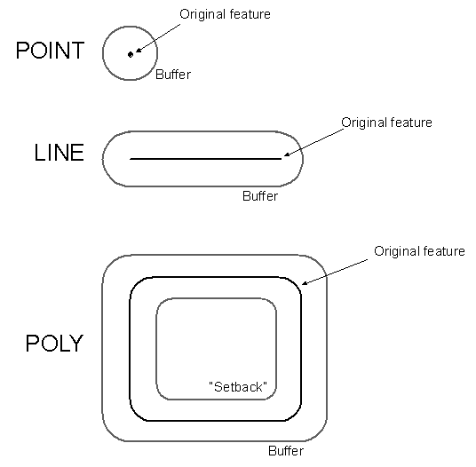
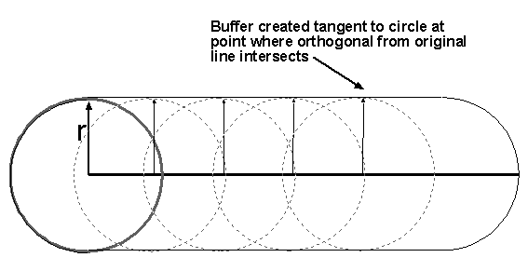
Buffers for Lines and Polygons
Move circle of specified radius along line
(or lines forming polygon)

Slide 4
Examples
In which zip code are survey respondents located? Campaign donors?
In which census tracts do we find Walmart stores? Payday lenders?
How proximate to liquor stores and bars do most crimes occur?

Slide 5
Proximity Tools
Buffer
Multiple Ring Buffer
Near
Point Distance

Slide 6
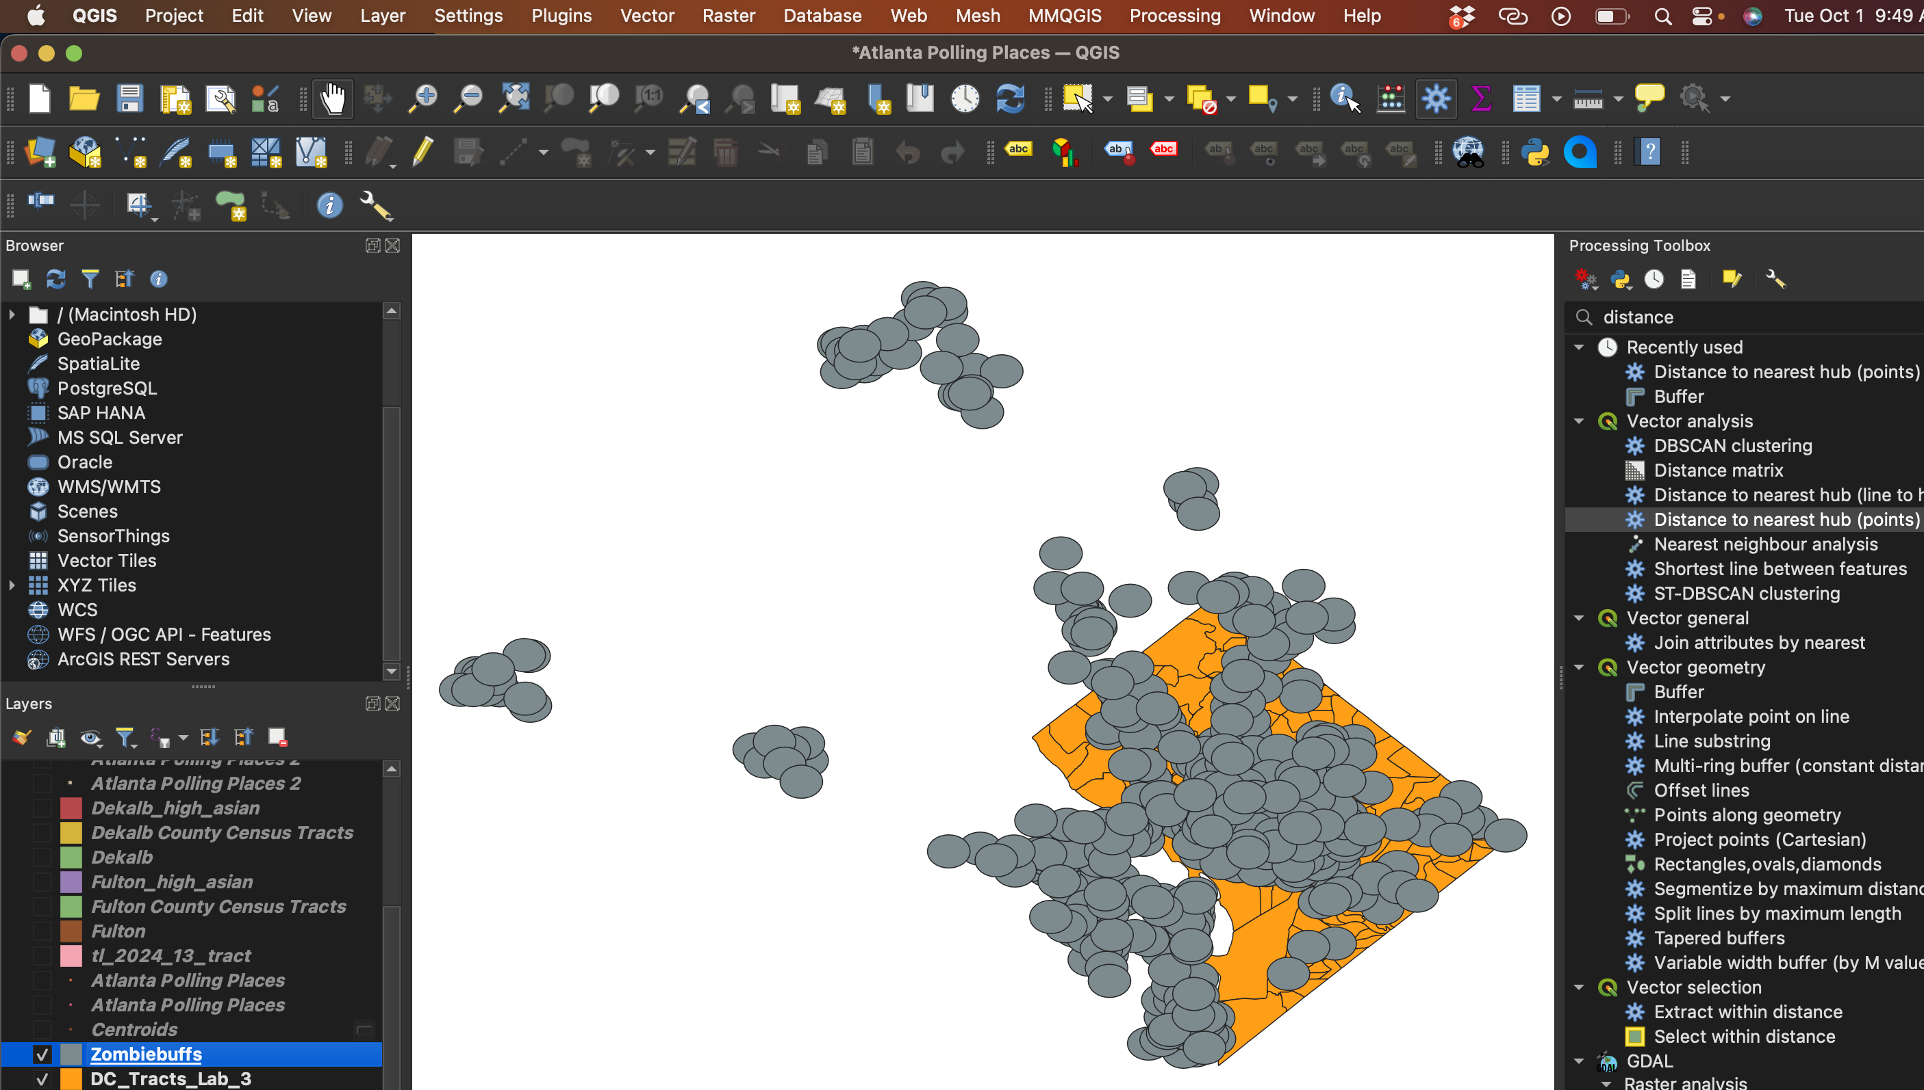

Slide 7
BUFFERS
Buffer zone - an area within a given ‘distance’ from a map feature • Points, lines, or polygons can be buffered
• Buffers are used to identify areas surrounding geographic features
• E.g. to keep septic systems over 100 meters away from streams, locate housing within a quarter mile of existing roads, keep hiking trails away from seasonally flooded rivers, or make sure most of your city is within some maximum distance from a fire station or school

Slide 8
Buffers - What is produced?
• When you buffer on a set of features, the output is a set of polygons.
• Buffering points or lines creates a new coverage that is a polygon coverage.
• Polygons define an inside and outside region • Inside region = an area less than the specified buffer distance from the feature(s) of interest
• Outside region = an area more than the specified buffer distance from the feature(s) of interest

Slide 9
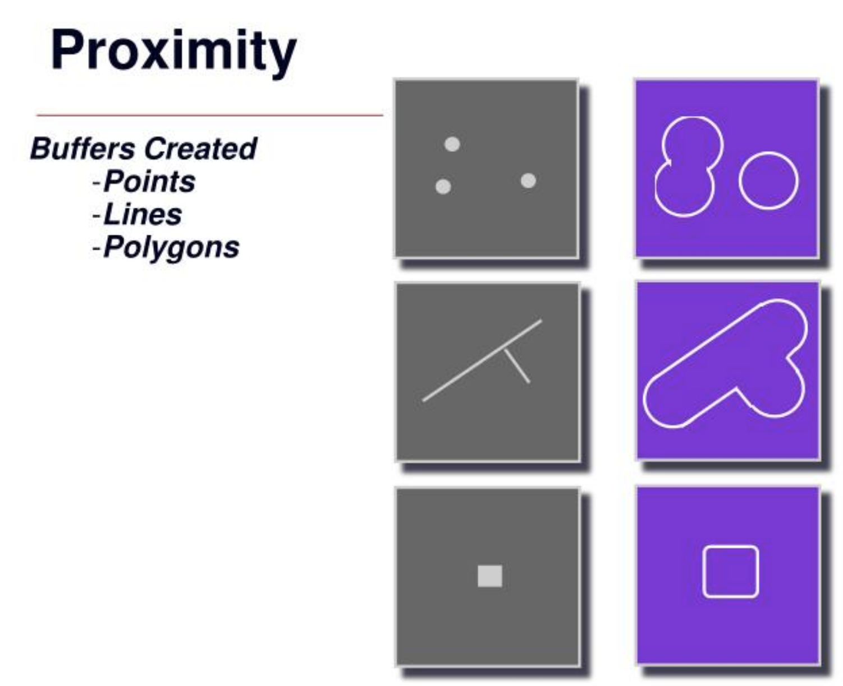

Slide 10
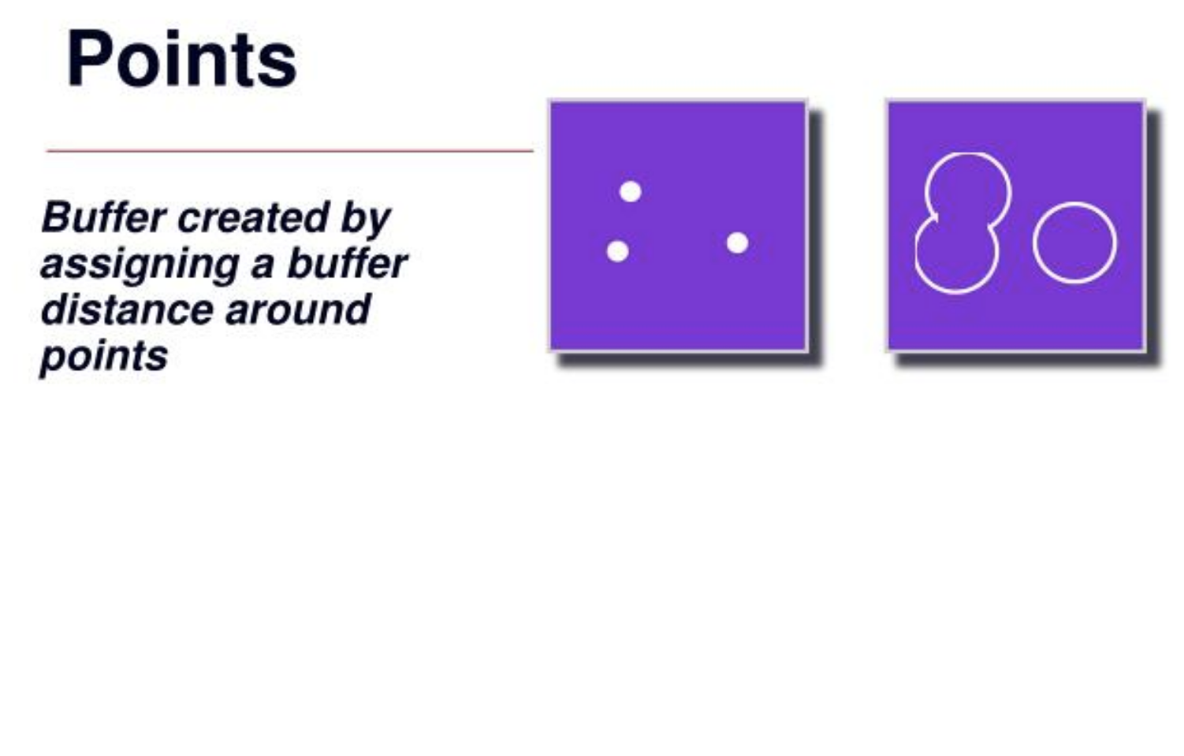

Slide 11
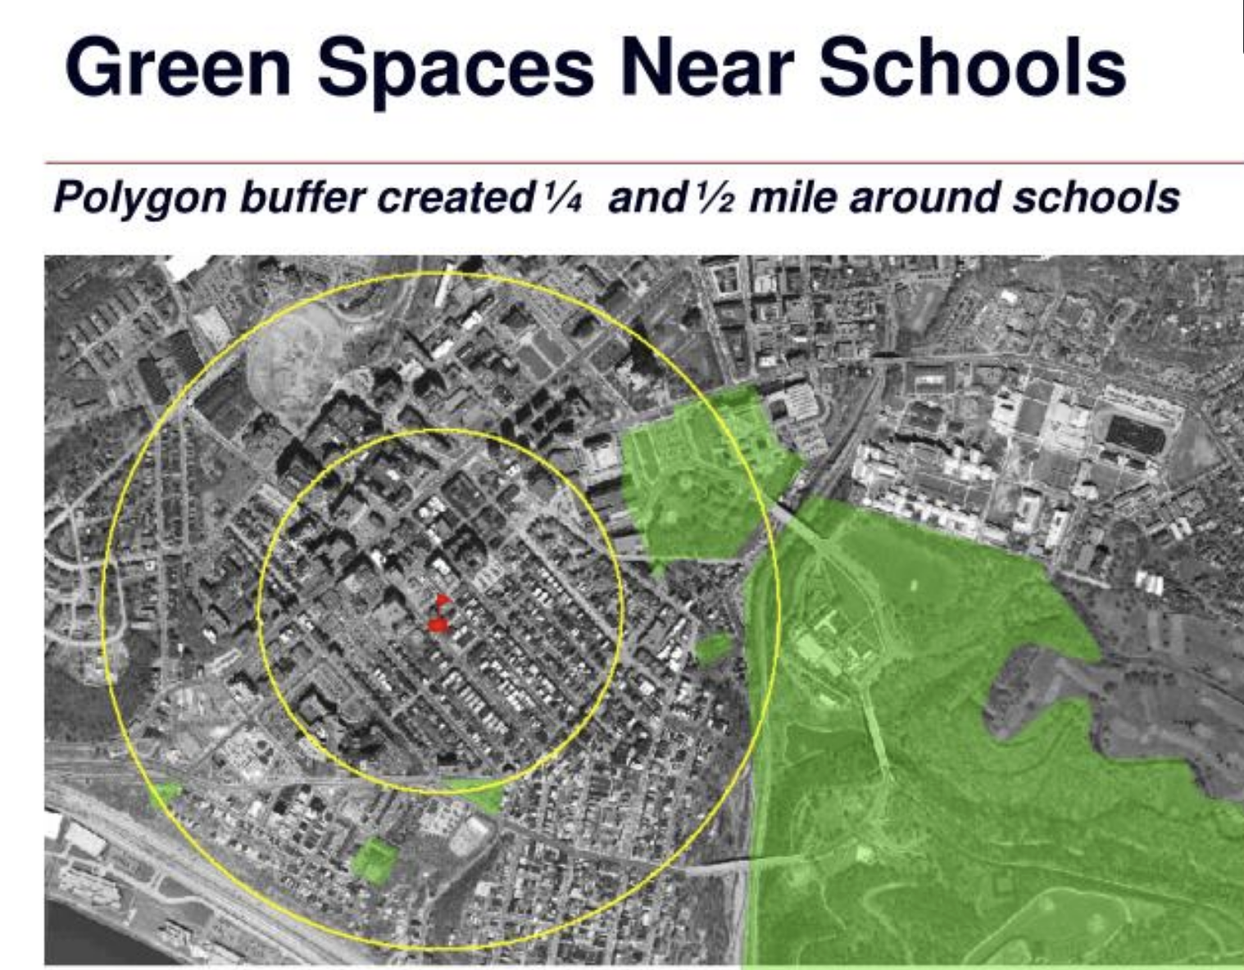

Slide 12
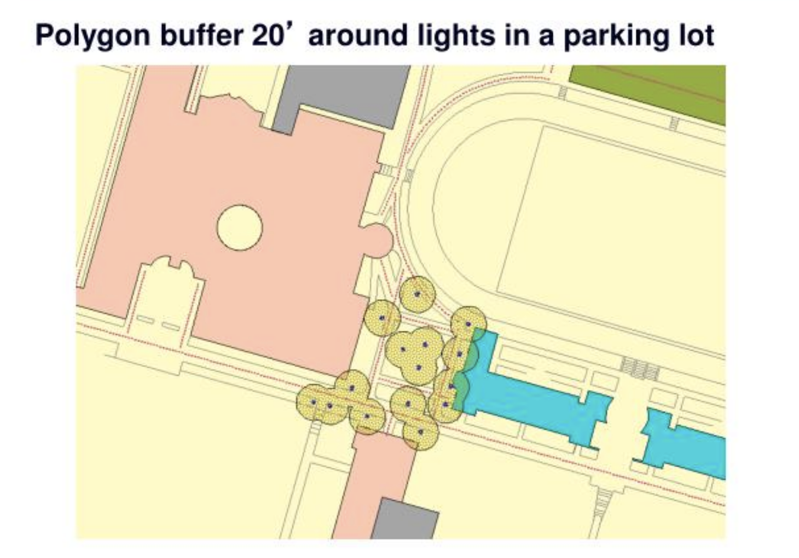

Slide 13
Introduction to Centroids
The centroid is the geometric center of a shape.
It is the point where a shape balances evenly in all directions.
Also referred to as the “center of mass” or “center of gravity.”
Common in fields like geometry, physics, and data science.

Slide 14
Centroids of Common Shapes
Triangle: The centroid is the point where the medians intersect.
Rectangle: The centroid is at the intersection of the diagonals.
Circle: The centroid is the center of the circle.
Visual: Illustrations of a triangle, rectangle, and circle with centroids marked.

Slide 15
Applications of Centroids
Geography: Centroids help in determining the geographical center of regions.
Machine Learning: K-means clustering uses centroids to group data.
Engineering: Used to find the center of gravity in structures.

Slide 16
